Slide 1

PLAY IT
REIMAGINED
An ultra-lightweight, high-performance Tic Tac Toe engine built with Vanilla JavaScript.

Slide 2
PROJECT VISION
Synthesizing nostalgia with modern web performance standards.

Slide 3

CORE PHILOSOPHY
Our design prioritizes instant playability. In a world of bloated applications, "Play it" focuses on the essentials: zero load times, intuitive UI, and flawless logic execution.
The goal was to create a "frictionless" gaming experience that adapts to any device seamlessly.

Slide 4






TECHNICAL FOUNDATION
SEMANTIC HTML5
MODERN CSS3
ES6+ JAVASCRIPT
Ensuring accessibility and structured DOM manipulation for screen readers and search engines.
Leveraging CSS Grid and Flexbox for a robust, responsive layout without external frameworks.
Clean, modular logic for win detection and state management with optimal memory usage.

Slide 5
GAME LOGIC
Deep dive into the win-detection algorithm and state management.

Slide 6


WINNING CONDITIONS
THE 3X3 GRID MATRIX
8 STRATEGIC COMBINATIONS
The game state is maintained in a single-dimensional array of 9 elements. This reduces overhead and simplifies indexing.
There are exactly 8 ways to win: 3 Horizontal, 3 Vertical, and 2 Diagonal. Our engine checks these 8 arrays after every move.
Win: [0,1,2], [3,4,5], [6,7,8] ...

Slide 7
PERFORMANCE METRICS
<4KB
0ms
100%
LOGIC SCRIPT SIZE
INPUT LATENCY
RESPONSIVENESS

Slide 8
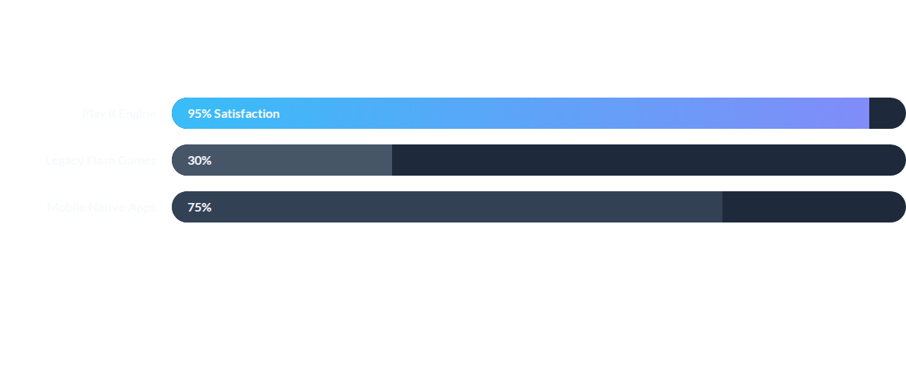
USER ENGAGEMENT COMPARISON
"Play it" outpaces legacy solutions by eliminating the need for downloads or third-party plugins.

Slide 9
DEVELOPMENT LIFECYCLE
PHASE 1
PHASE 2
PHASE 3
PHASE 4
Logic Prototyping
UI/UX Design
DOM Integration
Global Launch

Slide 10

"Simplicity is the final achievement. After one has played a vast quantity of notes, it is simplicity that emerges as the crowning reward of art."
— Frédéric Chopin

Slide 11
THE FUTURE
Our roadmap includes Minimax AI integration for single-player modes and real-time multiplayer capability via WebSockets.

Slide 12
THANK YOU
Questions? We are ready to discuss the implementation.
https://github.com/Sam78Svg/TicTacToeGame

Slide 13


IMAGE SOURCES
https://cdn.dribbble.com/userupload/45975667/file/7cb97b3ac35df406f73b8b509f5b8f1b.jpg?crop=0x261-1000x1011&format=webp&resize=400x300&vertical=center
Source: dribbble.com
https://images.stockcake.com/public/a/b/0/ab091079-9d33-400c-8d31-497414cbef46_medium/neon-data-interface-stockcake.jpg
Source: stockcake.com

